Slide 1

Modifier Types

Slide 2
After learning about classes and object we move onto certain keywords used in code

Slide 3


Remember our school example?
With multiple classes?
Spanish
Mathematics
Geography
German
Physics

Slide 4
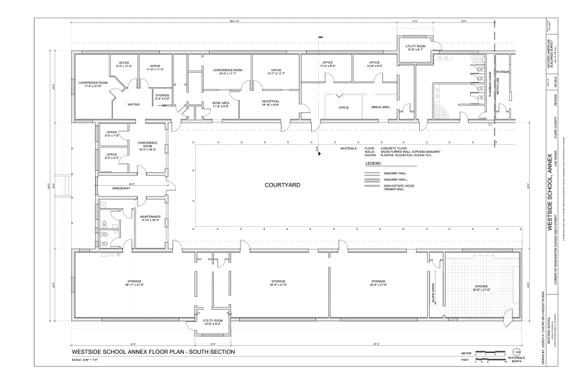

Can we enter all of them anytime?
Like in a normal school, you do not have access to any room anytime

Slide 5

Access Modifiers
public
private

Slide 6
Public
Definition
A class, method, variable, constructor, etc. that is declared as being public will be able to be accessed from any other class.

Slide 7
Public
Example
Any class is should be defined as being public if we want to access its contents and components
Main Method
has to be public all the time since it is the most important component of a program that has to be accessed by the other classes
Being public access means that the class(its door) is opened not closed
public static void main(String args[]){}

Slide 8
Public
Example
Mathematics.java
public class Mathematics
{
….
}
The Mathematics class is defined as being public
We have access to its methods from the School Class
School.java
class School
{
A class without a keyword as prefix is by convention declared as being public
public static void main(String args[])
{
Mathematics math = new Mathematics(34, “John Bury”);
math.getTeacherName();
}

Slide 9

Private
Think of this as a closed door of a method
We cannot get any information from it!

Slide 10
Private
School.java
public class School
{
public static void main(String args[])
{
} // main
} // School
Definition
When we put the ‘private’ keyword in front of a method, variable etc. then that method, variable or component can only be accessed within the class it is defined.
Physics.java
public class Physics {
….
private void schedulePeriod() {
if(time < 12) {
System.out.println(“Morning class”);
} // if
else if(time >= 12 && time < 18) {
System.out.println(“Afternoon class”);
} // else-if
else {
System.out.println(“No class”);
} // else
….
} // Physics
If the method schedulePeriod() from Physics class would be private then we would only be able to use it within the Physics

Slide 11
Private
Knock Knock
Definition
Who’s there?
When we put the ‘private’ keyword in front of a method, variable etc. then that method, variable or component can only be accessed within the class it is defined.
The School! Can you open the door?
Sorry! We are private
*Closed*
If the method schedulePeriod() from Physics class would be private then we would only be able to use it within the Physics
Nobody gets in or out!

Slide 12
Is it possible to have access to a private method?
School.java
public class School
{
public static void main(String args[])
{
} // main
} // School
The only way we can access components outside the class in which they are defined is by using the accessor methods which are declared as being public
YES
Mathematics.java
public class Mathematics {
int seatsAvailable;
String teacherName;
public Mathematics(int seats, String name)
{
seatsAvailable = seats;
teacherName = name;
} // Constructor
public void getTeacherName() {
System.out.println(“The mathematics teacher is called ”+ teacherName);
} // getTeacherName
}
is by using the accessor methods which are declared as being public

Slide 13
Review
public
public class Test {}
Access Modifiers
private
private int test;
A component that is declared as being public can be accessed from any class
public
A component that is defined as being private can only be accessed within the class it is declared
private

